Slide 1
CMR INSTITUTE OF TECHNOLOGY
AUTOMATING E-GOVERNMENT SERVICES WITH ARTIFICIAL INTELLIGENCE
M.Akkashh 16R01A05M8
B.Sreeshma 16R01A05N9
G.Sahithi 16R01A05L2
V.Mrunalini 16R01A05P7
Under the Guidance of Dr.S.Alagumuthukrishnan

Slide 2
CONTENTS
INTRODUCTION
ABSTRACT
EXISTING SYSTEM
PROPOSED SYSTEM
SAMPLE OUTPUT
CONCLUSION
REFERENCES

Slide 3
INTRODUCTION
E-government is the application of employing advanced electronic techniques–and web services–to present, exchange, and advance the government’s services for citizens and businesses with a goal of improving the productivity while reducing the cost.
Artificial Intelligence (AI) has recently advanced the state-of-art results in an ever-growing number of domains. AI can be defined as the ability of a computer to imitate the intelligence of human behaviour while improving its own performance
Objective : to minimize processing times, reduce costs, and improve citizens satisfaction.
Our overarching goal is to utilize trustworthy AI techniques in advancing the current state of e-government services

Slide 4
ABSTRACT
Here, we address the challenges of e-government systems and propose a framework that utilizes AI technologies to automate and facilitate e-government services.
Specifically, we first outline a framework for the management of e-government information resources.
Second, we develop a set of deep learning models that aim to automate several e-government services.
Third, we propose a smart e-government platform architecture that supports the development and implementation of AI applications of e-government.

Slide 5
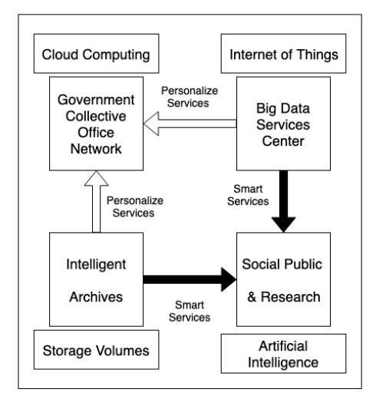
Architecture
An architecture overview for
a centralized e-government information management framework.

Slide 6
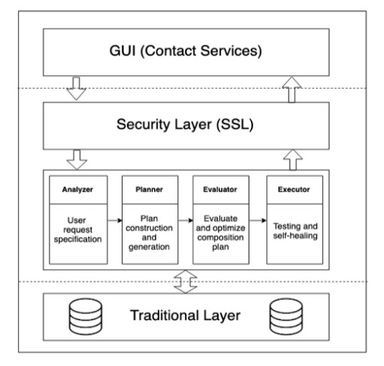
Architecture overview for
a smart e-government services platform.

Slide 7
EXISTING SYSTEM
DISADVANTAGES
Artificial Intelligence (AI) has recently advanced the state-of-art results in an ever-growing number of domains.
However, it still faces several challenges that hinder its deployment in the e-government applications both for improving the e-government systems and the e-government-citizens interactions.

Slide 8
PROPOSED SYSTEM

Slide 9
ADVANTAGES
With the recent advances in AI and deep learning technologies, more government agencies are starting to use such technologies to improve their systems and services.
However, a large set of challenges hinder the adoption of such technologies, including the lack of experts, computational resources, trust, and AI interpretability.

Slide 10
SAMPLE OUTPUT

Slide 11
CONCLUSION
With the recent advances in AI and deep learning technologies, more government agencies are starting to use such technologies to improve their systems and services. However, a large set of challenges hinder the adoption of such technologies, including the lack of experts, computational resources, trust, and AI interpretability.
The overarching goal of this paper is to introduce new frameworks and platform to integrate recent advances in AI techniques in the e-government systems and services to improve the overall trust, transparency, and efficiency of e-government.

Slide 12
REFERENCES
K. He, X. Zhang, S. Ren, and J. Sun, ‘‘Deep residual learning for image recognition,’’ in Proc. IEEE Conf. Comput. Vis. Pattern Recognit., Jun. 2016, pp. 770–778.
Y.-D. Zhang, Y. Zhang, X.-X. Hou, H. Chen, and S.-H. Wang, ‘‘Sevenlayer deep neural network based on sparse autoencoder for voxelwise detection of cerebral microbleed,’’ Multimedia Tools Appl., vol. 77, no. 9, pp. 10521–10538, May 2018.
S. Venugopalan, H. Xu, J. Donahue, M. Rohrbach, R. Mooney, and K. Saenko, ‘‘Translating videos to natural language using deep recurrent neural networks,’’ 2014, arXiv:1412.4729.
D. Silver, A. Huang, C. J. Maddison, A. Guez, L. Sifre, G. van den Driessche, J. Schrittwieser, I. Antonoglou, V. Panneershelvam, M. Lanctot, S. Dieleman, D. Grewe, J. Nham, N. Kalchbrenner, I. Sutskever, T. Lillicrap, M. Leach, K. Kavukcuoglu, T. Graepel, and D. Hassabis, ‘‘Mastering the game of Go with deep neural networks and tree search,’’
C. Bishop, Pattern Recognition and Machine Learning. New York, NY, USA: Springer, 2006.

Slide 13
THANK YOU

